Slide 1
Hackathon structure
Challenge based
Free form
There are three challenges to complete, one building upon the other
You choose the language, framework, technologies you wish to use
Explore and play
Ground rules
While the core is to create a front-end interface and a back-end API, you are encouraged to venture off onto any side quest you desire
The intent of the hackathon is to build the project as if you were back at your desk writing production code – using Copilot to assist you
Notes:
Highlight the importance of exploration, which is the primary goal of the structure of the event

Slide 2
Overview
Today we are going to use Copilot to build a simple “stock ticker“ - it will have a front-end and a back-end
You are free to use the IDE, language(s) and framework(s) of your choosing
We will provide you sample stock ticker data
The challenge has basic requirements and stretch goals
Once the clock starts you will have ~4 hours to code
Everyone will have 2-3 mins to present their work and share a tip on how they used Copilot to build their project

Slide 3
Environment Setup
Choose your language
Choose your IDE
Install the Copilot extension for your IDE
Clone the project
Follow the instructions in the README.md
Once you have the sample application running, raise your hand
Notes:
Typescript: im-copilot-sandbox/hackathon-typescriptreact-memorygame (github.com)
C#: im-copilot-sandbox/hackathon-csharpblazor-memorygame: Starter code for the C# Blazor Memory Game Hackathon. (github.com)

Slide 4
Getting Help
If you need assistance, raise your hand in Teams
A facilitator will reach out to you to help get things sorted

Slide 5
How are Projects Judged?
Was Copilot used to implement more than 60% of the functionality?
Is application functional?
Does it meet basic requirements?
How many stretch goals does it meet?
Overall polish
Best use of Copilot to build feature X or best Copilot lessons learned

Slide 6
Getting the most out of GitHub Copilot
Northern Trust Hackathon
August 1, 2025
Notes:
Because the workshop primarily focuses on Code Completion and Chat, those are the only services we cover during the presentation. You are free to include others if you like, but make sure the customer has access to them so as not to cause confusion.

Slide 7
Overview of GitHub Copilot
Prompt crafting and LLMs
Introducing the workshop

Slide 8
GitHub Copilot
Your AI pair programmer

Slide 9

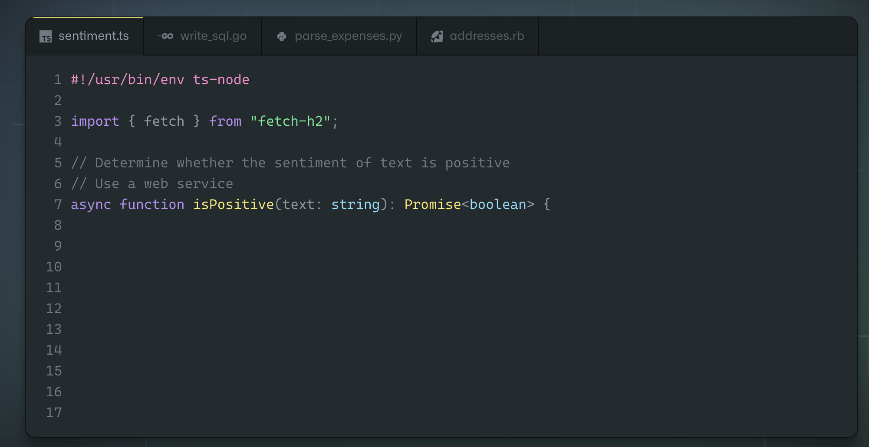
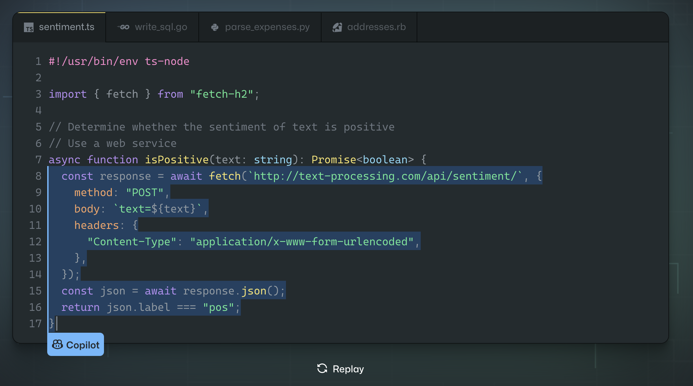
GitHub Copilot
Your AI pair programmer
Uses the context you’ve provided and synthesizes code to match
Convert comments to code
Autofill for repetitive code
Streamline test creation
Show alternatives
Notes:
We’re starting with Code Completion, which is the one most developers are already familiar with. It’s also a good foundation for introducing chat.

Slide 10
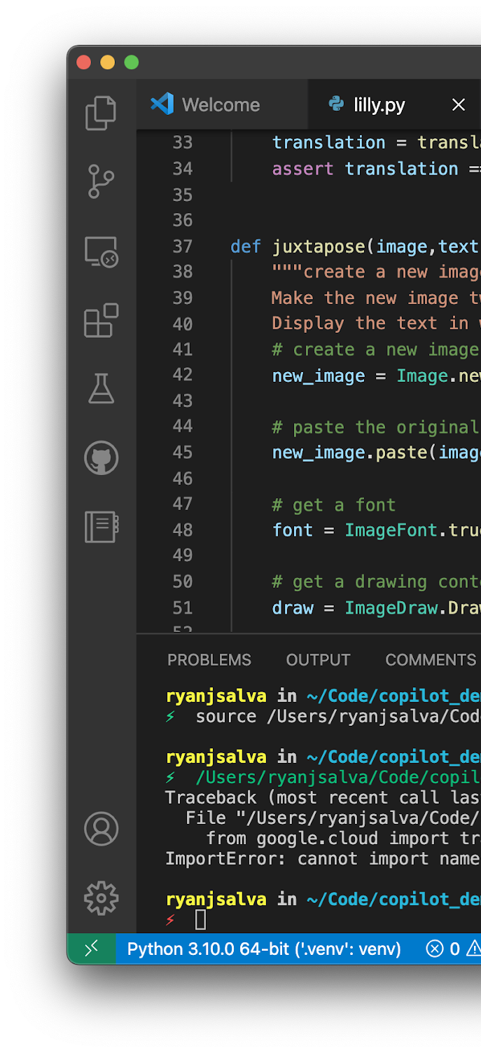




PUBLIC DATA
OPENAI
GPT LLM
CONTEXT
SUGGESTIONS
Notes:
Walk through the flow, adding whatever context you would like. Try to avoid deep conversations about indemnity (defer to the trust center), the version of Open AI GPT (not as important given the customizations done), or on context (it’s important, but sometimes developers can rabbit hole)

Slide 11
Answers to common questions
Does GitHub Copilot train on my code?
What is included in the context?
Can’t I just write the code on my own?
No. When using GitHub Copilot for Business, none of your code is stored by GitHub.
Context includes the file you are working on, and tabs open in the IDE starting from the current file.
As developers, we write an awful lot of boring code. Offloading this code to GitHub Copilot allows you to focus on the important problems.
Notes:
You can skip this slide if you like, especially if you’ve already opened the floor for questions. These are by far the most common questions developers ask about GitHub Copilot.

Slide 12
Demo
Notes:
Use your favorite demo! I like to build a Django application

Slide 13
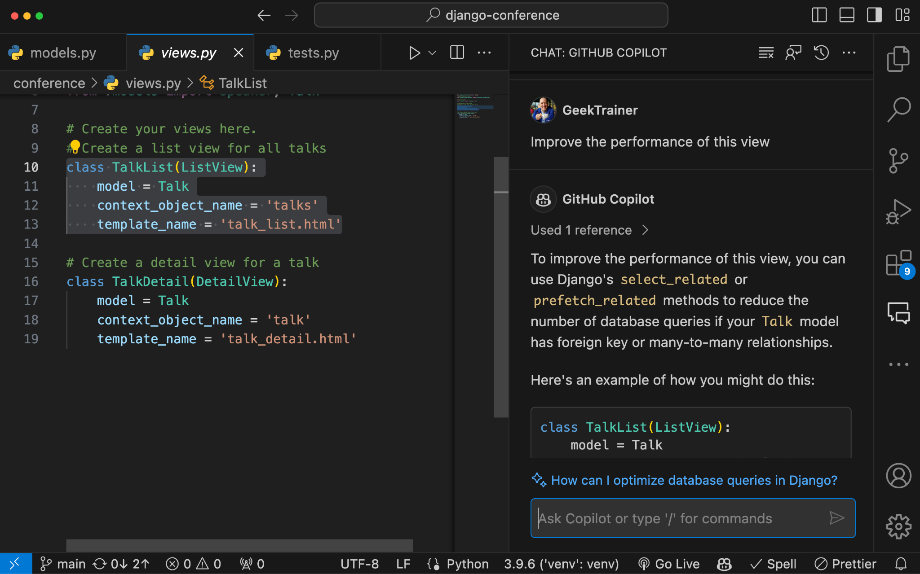
GitHub Copilot Chat
ChatGPT-like experience in editor
Generic questions
Generate unit tests
Explain the code
Propose a fix for bug
Make code robust / secure
Support VS Code
and Visual Studio
(JetBrains in private beta)
Notes:
Talk about GitHub Copilot Chat

Slide 14
Demo
Notes:
Highlight a block of code and generate unit tests, or ask it to explain the code, or improve performance, or some combination thereof.

Slide 15
Prompt crafting
Helping GitHub Copilot help you

Slide 16
Help GitHub Copilot help you
Context
Intent
Clarity
Specificity
Information provided to help GitHub Copilot understand the task better
The specific goal or purpose you have in mind when creating a prompt
The quality of being easy to understand
The level of detail and precision
Notes:
Context: Without context, Copilot will return suggestions that aren’t as tailored to your requirements as they could be
Intent: Identify the end goal and state it in your prompt. For example “I need to create a calculator class that will calculate sin, cos, and tan”.
This establishes our intent that Copilot should return a code suggestion that creates the calculator class with your specific functions.
Clarity: Avoid ambiguous language when writing prompts so you reduce the risk of Copilot misinterpreting what it is you want.
Specificity: Prompts that include specifics to take into account help GitHub Copilot generate more relevant and accurate responses. For example, if I want to Copilot to return a suggestion that uses a specific library, it helps to indicate the specific version you want to use. The same would apply when defining a function and telling Copilot the different edge cases and data types to use.

Slide 17
Good code begets good code
Use good names
Spell out variable names
GitHub Copilot understands natural language
Single letter variables and abbreviations are ambiguous
Keep functions functional
Be consistent
Follow strong principles when creating named blocks
Generated code follows contextual patterns
Notes:
Developers often ask if there’s a way to tell GitHub Copilot about the style guide they have. This is a good opportunity to answer that question and encourage them to write good code to help GitHub Copilot generate good code.

Slide 18
GitHub Copilot is probabilistic, not deterministic
Copilot’s LLMs are sophisticated probability engines, so you might not get the same results for the exact same prompts every time
Notes:
Copilot users will most likely receive unique code suggestions with each prompt, as it’s LLM’s perform in a probabilistic way.

Slide 19
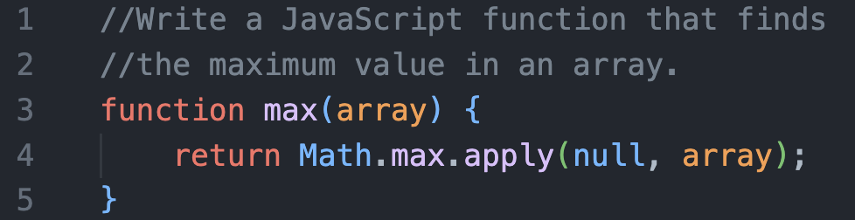
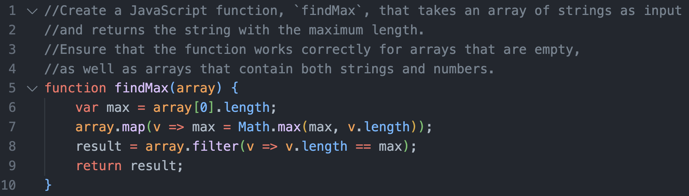
If at first you don’t succeed, iterate!
Initial prompt
Second prompt
Notes:
If Copilot doesn’t provide back a suggestion that fits your use case, build on original prompt to include additional details that you think would help produce a better code suggestion

Slide 20
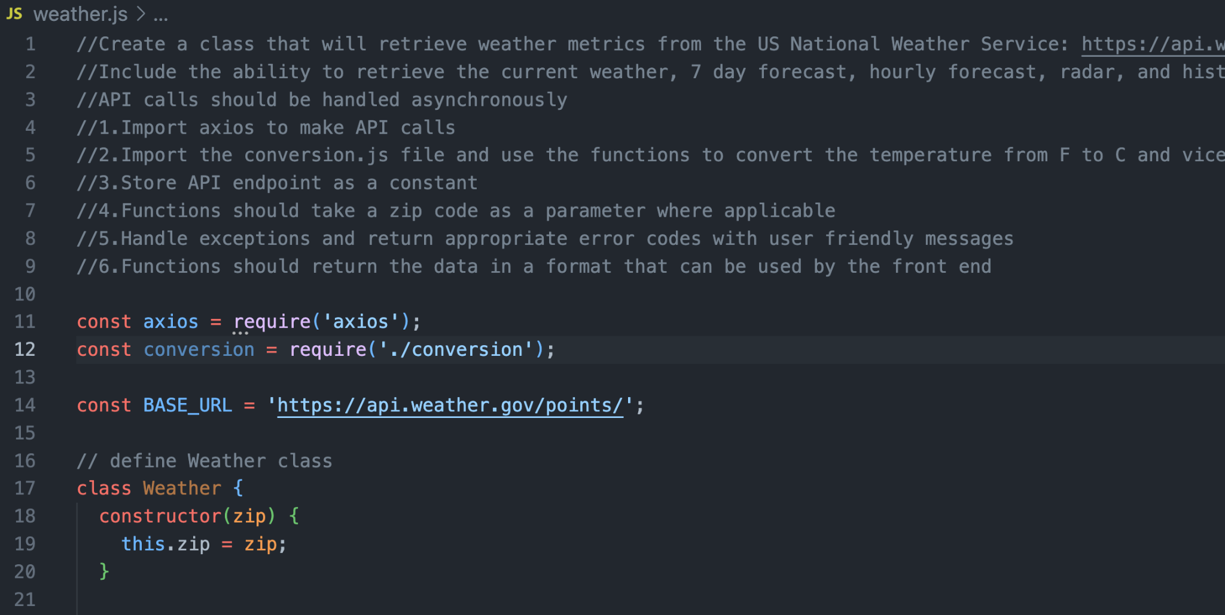
Include a high level description of your requirements at the top of your file.
Notes:
In this example, I’m creating a web application that would allow users to retrieve weather information for a zip code they specify. This is certainly much longer than a developer would write in the real world, but it does a good job showing off the core pillars layed out above.
Let’s relate this prompt back to the core pillars we just discussed:
Context: The prompt itself contains context I want Copilot to take into consideration when generating a code suggestion
Intent: On lines 1-3, I’m describing the the end goal of what I want my code to accomplish: retrieve weather information from the US National Weather Service and handling my API calls asynchronously
Clarity: Throughout my prompt I’m brief but descriptive in what I want the code to do
Specificity: From lines 2-9, I break down exactly what should be included in the code suggestion returned back from Copilot so I increase the probability of getting back a code suggestion that fits my needs
For example: I tell it to use axios to handle API calls
Store the API as a constant so that I don't have to update it in multiple places should the endpoint change in the future
Use zip code as a parameter
Handle exceptions where the zip code may not be provided or is invalid
Return the data in a format that makes it easy for me to parse and present on the front end of my application

Slide 21
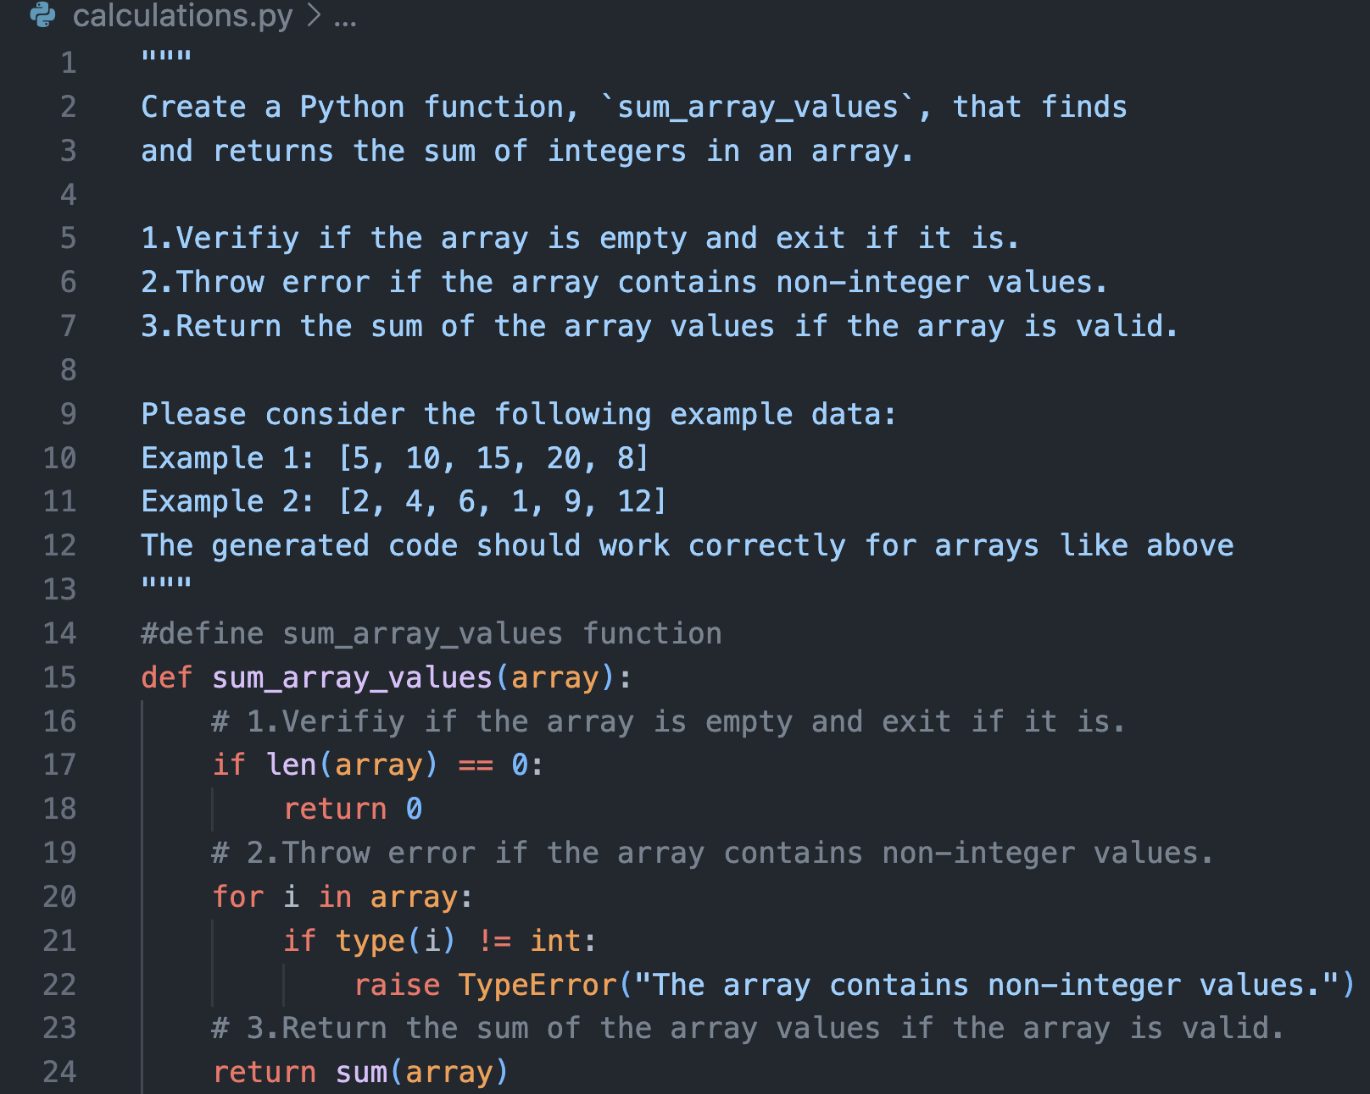
Provide examples in your prompt to clarify your expectations for the logic Copilot should take into consideration
Notes:
Because GitHub Copilot is an LLM, which is great at pattern recognition, providing examples (if applicable) will yield great results

Slide 22
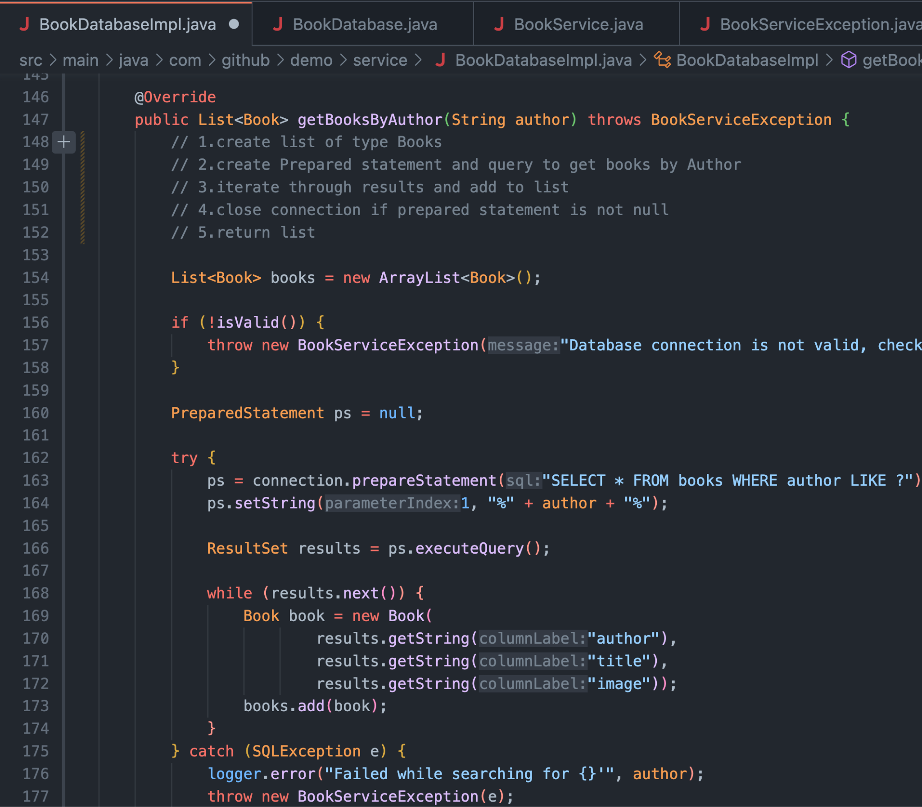
Keep files open that are relevant to the requirements of your current file.
Notes:
if you want Copilot to have additional context outside of just prompts and lets say, use methods, services, libraries, etc defined elsewhere in your project, open those files in your IDE! Copilot will take that context into consideration and incorporate existing patterns into the code suggestions it returns!
This will give Copilot additional context that it can use to incorporate those functions and standardizations into the code suggestions that are returned! Also highlight that GitHub Copilot starts from the current tab and works its way out from there.

Slide 23
Key tips to remember
GitHub Copilot looks at tabs
Consider closing all tabs when context switching to ensure GitHub Copilot sees what you need it to see.
Formality isn’t required
A couple of lines of comments or a bit of pseudocode go a long way.
There isn’t one right way to use GitHub Copilot
Because LLMs are probabilistic, you may see different responses for the same prompts. Being flexible is the best way to ensure success.
Notes:
A quick review of the concepts from before

Slide 24
Above all else,
go with the flow

Slide 25
The workshop
That’s great and all… But when can I write code?

Slide 26
Build an app for users to see if their flight will be delayed
Notes:
If you have a solution built, demonstrate it here so attendees can see the direction they’re heading

Slide 27
The challenges
Create and export a model and data
Given a CSV file containing US flight information, create a model to predict if a flight will be delayed
Expose the model and data via an API
Create an API for a frontend client using the language and framework you desire
Build a frontend which calls the API
Create any form of a frontend for users
Notes:
Open the website and show the pages where the challenges are described

Slide 28
Workshop structure
Challenge based
Free form
There are three challenges to complete, one building upon the other
You choose the language, framework, technologies you wish to use
Explore and play
Possible solutions
While the core is to create a model and expose an API and frontend, you are encouraged to venture off onto any side quest you desire
While guides are available, the design of the workshop is to build the project like you would if you were back at your desk writing production code
Notes:
Highlight the importance of exploration, which is the primary goal of the structure of the event

Slide 29
Tips for success
Explore!
Try it!
This is your opportunity to try things, break things, and learn!
Not sure if something works, if a feature is supported, or how to build a prompt? Try it!
Ask!
Run wild!
We’re here for you, not the other way around. We can answer all your questions!
There’s limited guardrails on the project. Build what you want how you want!
Notes:
Be very clear about the fact that attendees can ask questions! While we are encouraging them to explore on their own (which they should), this can sometimes lead people to get stuck and not ask for help.

Slide 30
Resources
Notes:
Update this slide to include any links to the chat channel, documentation, or other resources for the hackers. The URL for the workshop is on the next page.

Slide 31
Let’s build!
<INSERT URL HERE!!!>
Notes:
Update this slide to include the URL for the workshop

Slide 33
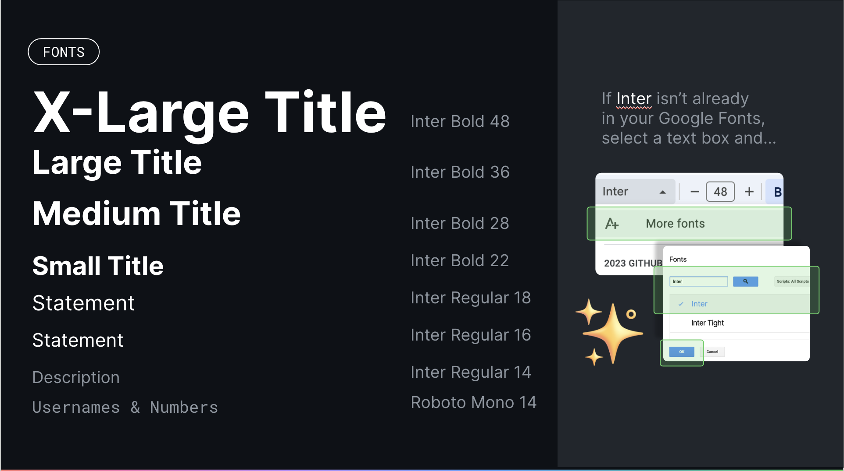
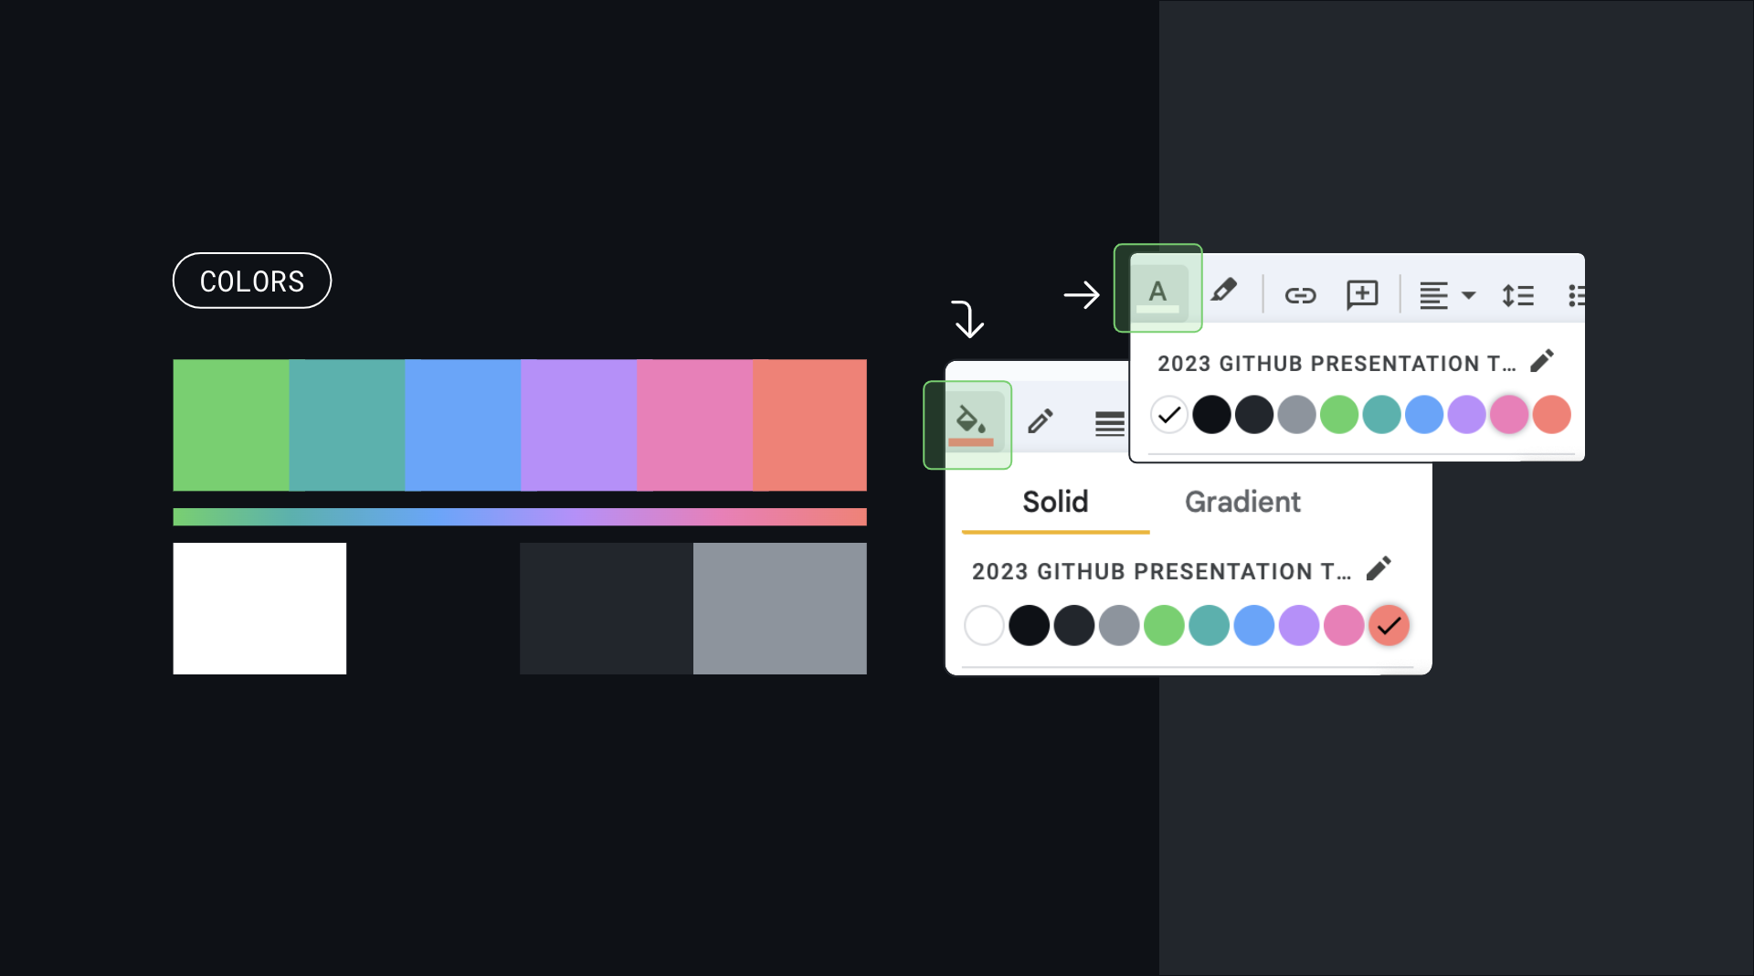
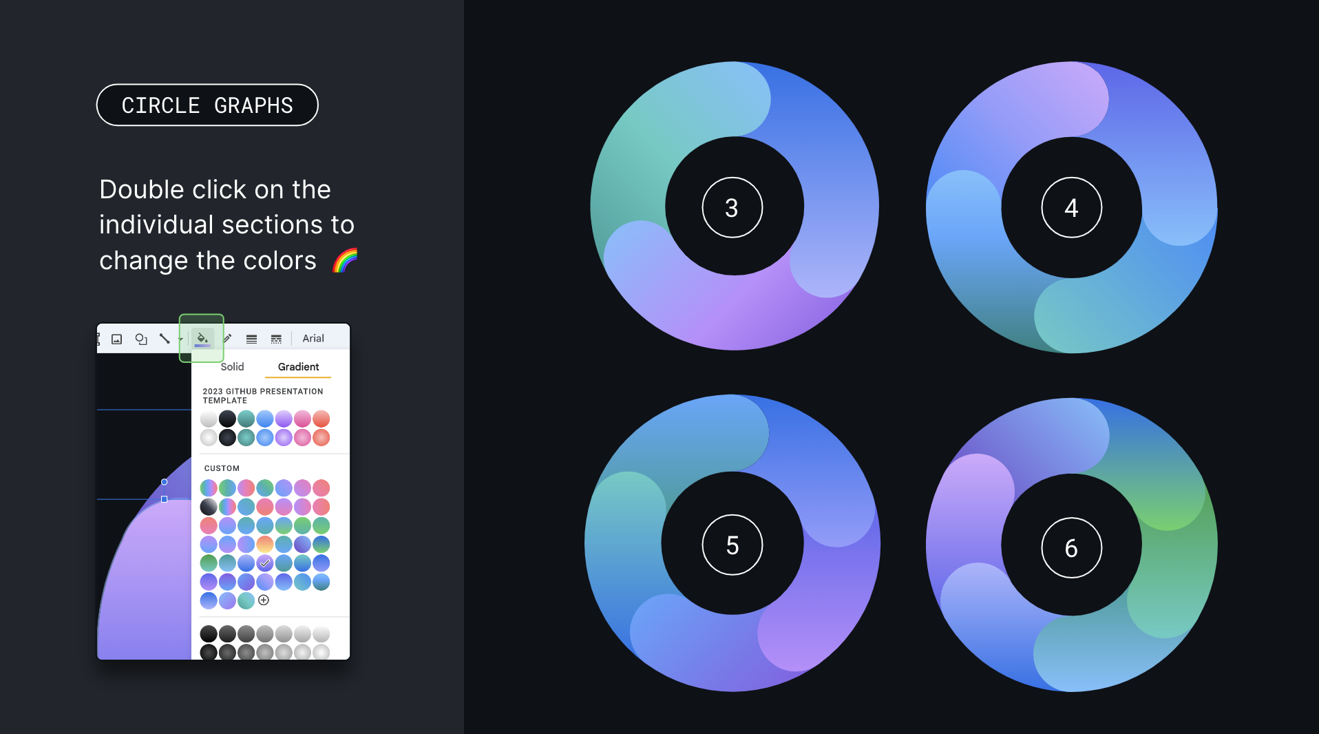
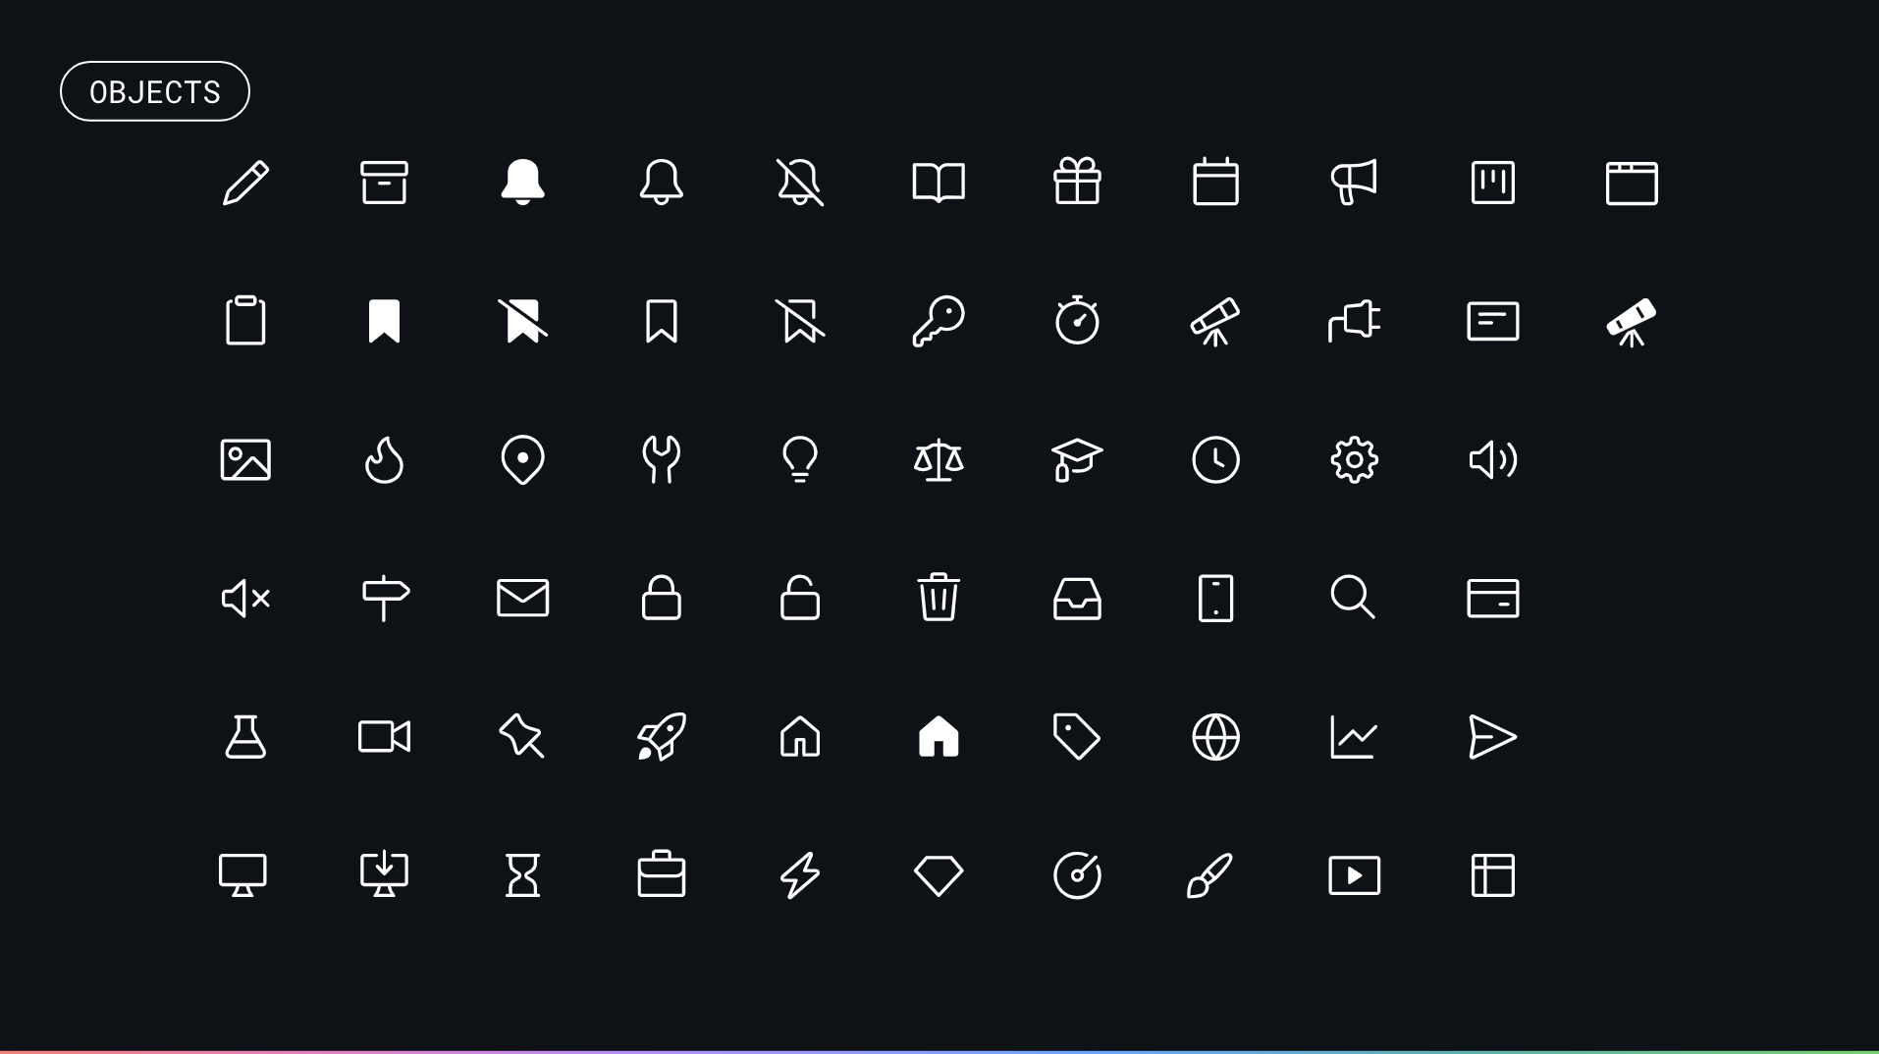
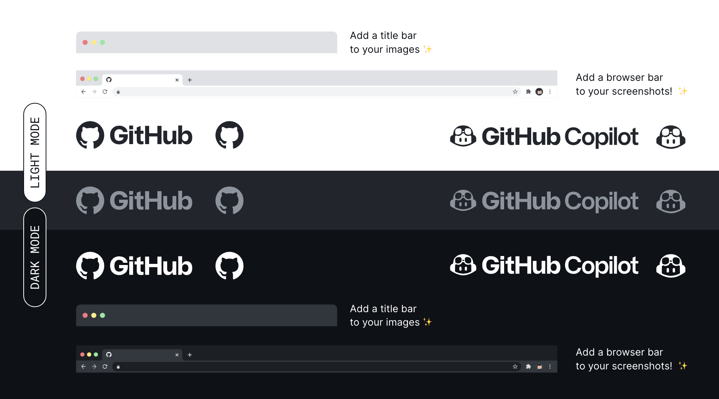

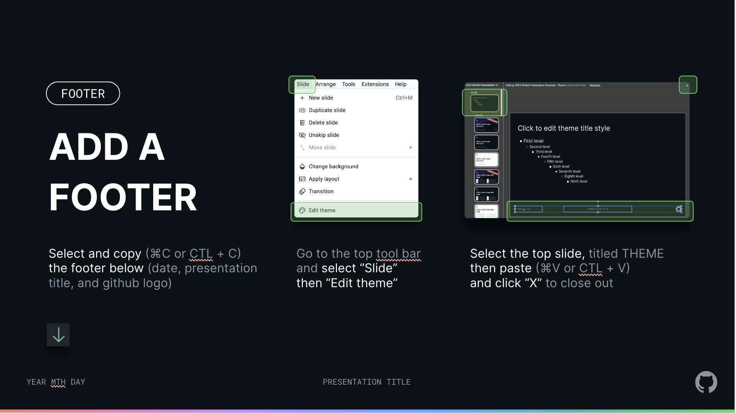
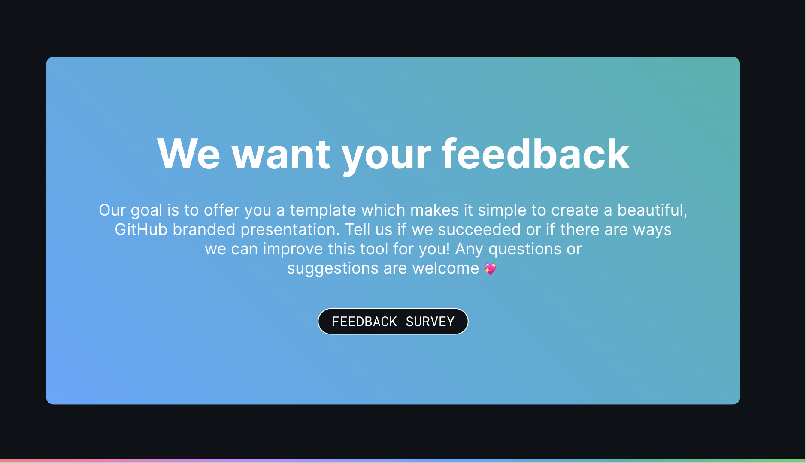
Check out the following slides for presentation tools & guidelines
FONTS
COLOR
CIRCLE GRAPHS
OCTICONS
LOGOS & TITLE BARS
MONAMOJIS
FOOTER
FEEDBACK
PRESENTATION TOOLS

Slide 34
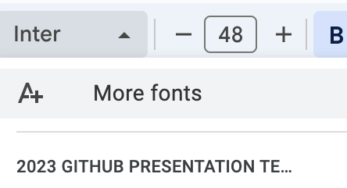
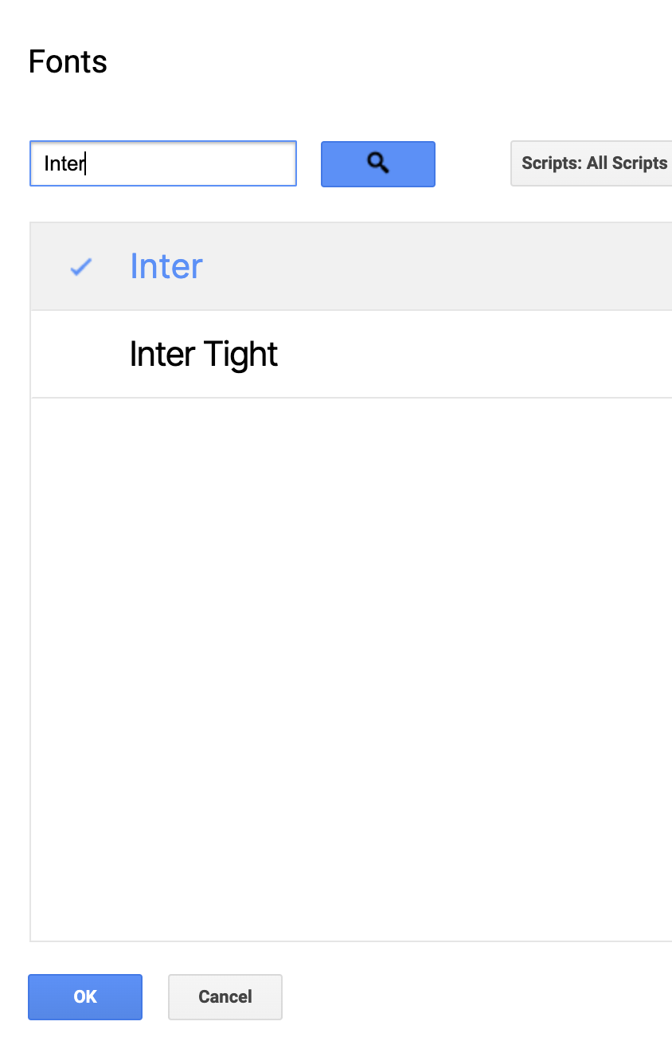

X-Large Title
Inter Bold 48
If Inter isn’t already in your Google Fonts, select a text box and…
Large Title
Inter Bold 36
Medium Title
Inter Bold 28
Small Title
Inter Bold 22
Statement
Inter Regular 18
Statement
Inter Regular 16
Description
Inter Regular 14
Description
Inter Regular 12
Usernames & Numbers
Roboto Mono 12
FONTS

Slide 35
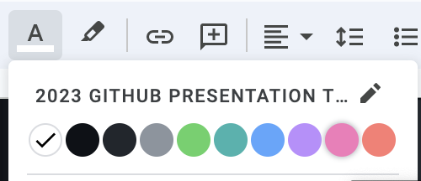
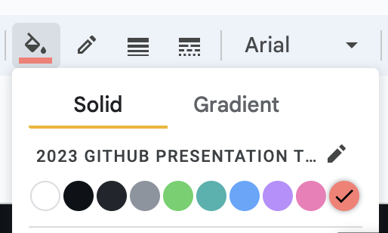
COLORS

Slide 36
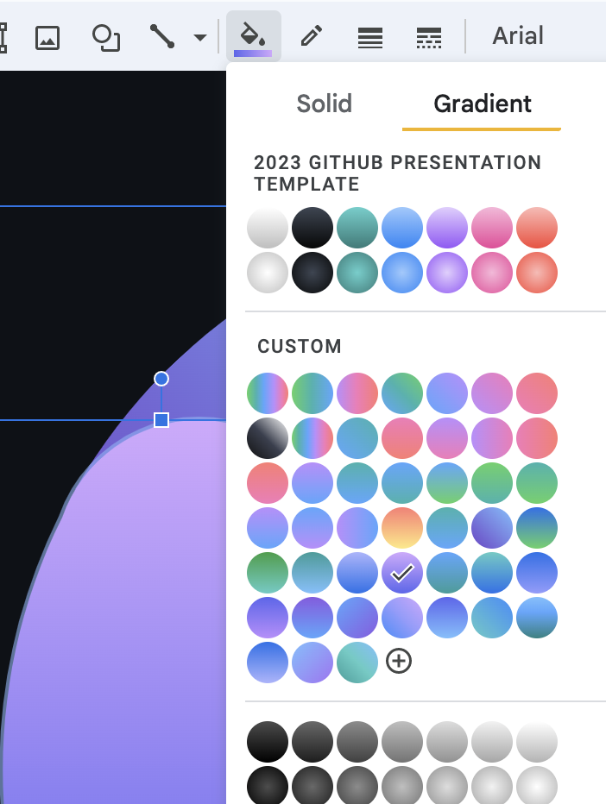
CIRCLE GRAPHS
Double click on the individual sections to change the colors 🌈
3
4
5
6

Slide 37


Please do
Please don’t
OCTICONS
In the following slides, you will have access to our vector Octicon Library, which you can use throughout your presentation!
The icons are vectors which means you can change the colors (remaining within the provided GitHub brand colors)
The icons are already properly sized. Please refrain from resizing them.

Slide 38
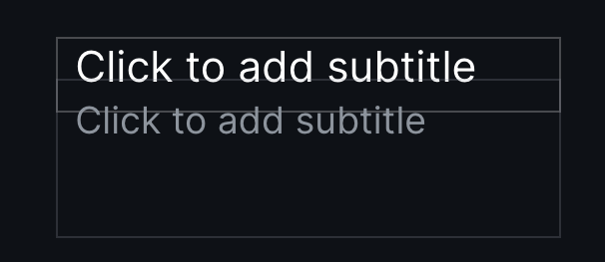
OCTICONS
When you see text boxes like this…
Add an icon above to visually represent your information!
And don’t forget to play with color!
You’re doing great
You’re doing great
Keep it up!
Keep it up!

Slide 39
PEOPLE

Slide 40
OBJECTS

Slide 41
SYMBOLS

Slide 42
SYMBOLS

Slide 43
DEVELOPER

Slide 44

Add a title bar to your images ✨
Add a browser bar to your screenshots! ✨
LIGHT MODE
DARK MODE
Add a title bar to your images ✨
Add a browser bar to your screenshots! ✨

Slide 45





















MONAMOJIS
FOR INTERNAL USE ONLY!
…if you use the monamojis for external/public facing presentations

Slide 46
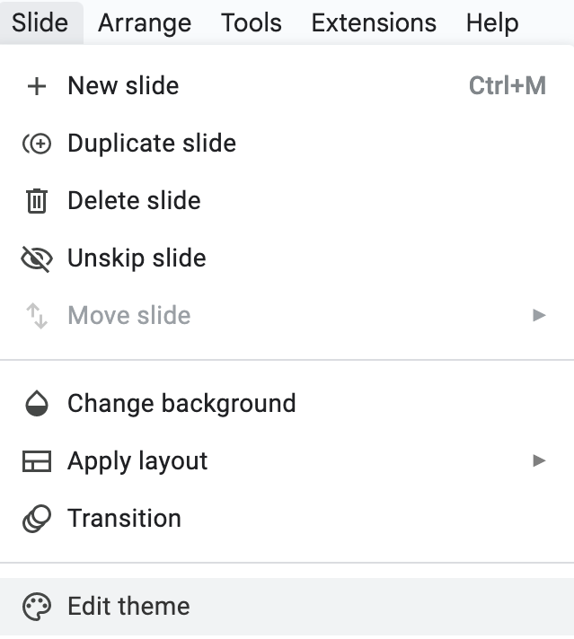
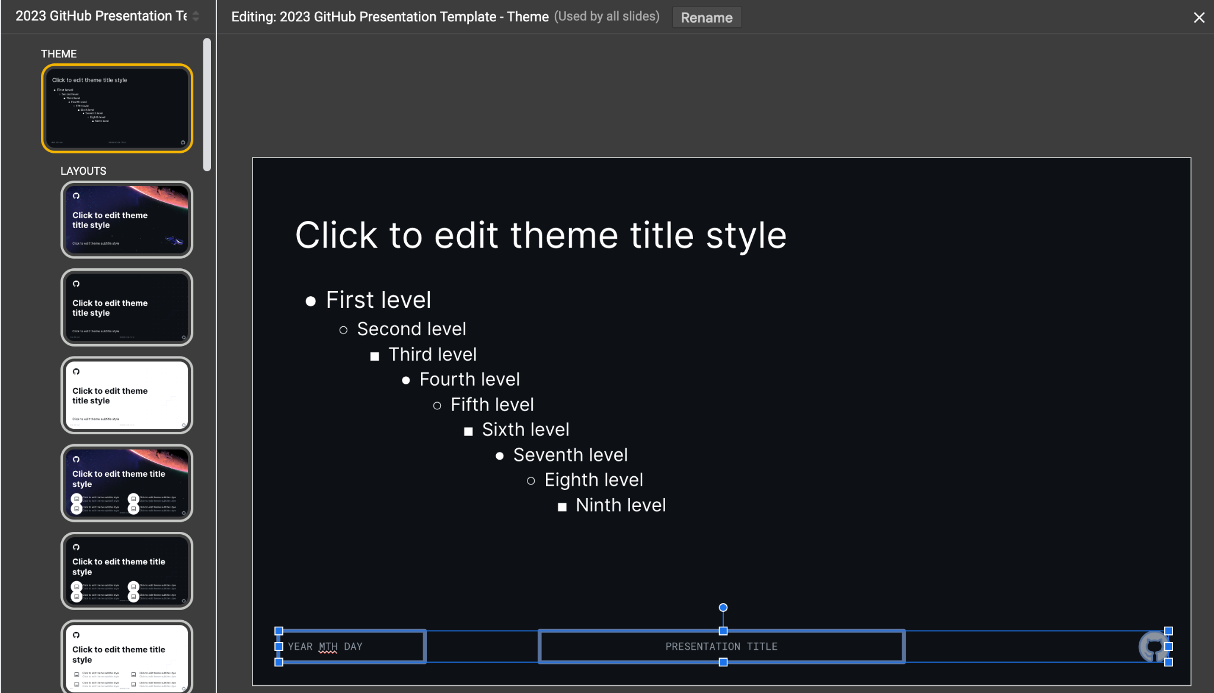
FOOTER
If you want to add a footer
Select and copy (⌘C or CTL + C) the footer below (date, presentation title, and github logo)
Go to the top tool bar and select “Slide” then “Edit theme”
Select the top slide, titled THEME then paste (⌘V or CTL + V),
edit, and click “X” to close out
YEAR MTH DAY
PRESENTATION TITLE

Slide 47
We want your feedback
Our goal is to offer you a template which makes it simple to create a beautiful, GitHub branded presentation. Tell us if we succeeded or if there are ways we can improve this tool for you! Any questions or suggestions are welcome 💖
FEEDBACK SURVEY

